Slide 1
WSTA Lecture 15
Tagging with HMMs
Tagging sequences
  modelling concepts
  Markov chains and hidden Markov models (HMMs)
  decoding: finding best tag sequence
Applications
  POS tagging
  entity tagging
  shallow parsing
Extensions
  unsupervised learning
  supervised learning of Conditional Random Field models

Slide 2
Markov Chains
Useful trick to decompose complex chain of events
  into simpler, smaller modellable events
Already seen MC used:
  for link analysis
    modelling page visits by random surfer
    Pr(visiting page) only dependent on last page visited
  for language modelling:
    Pr(next word) dependent on last (n-1) words
  for tagging
    Pr(tag) dependent on word and last (n-1) tags

Slide 3
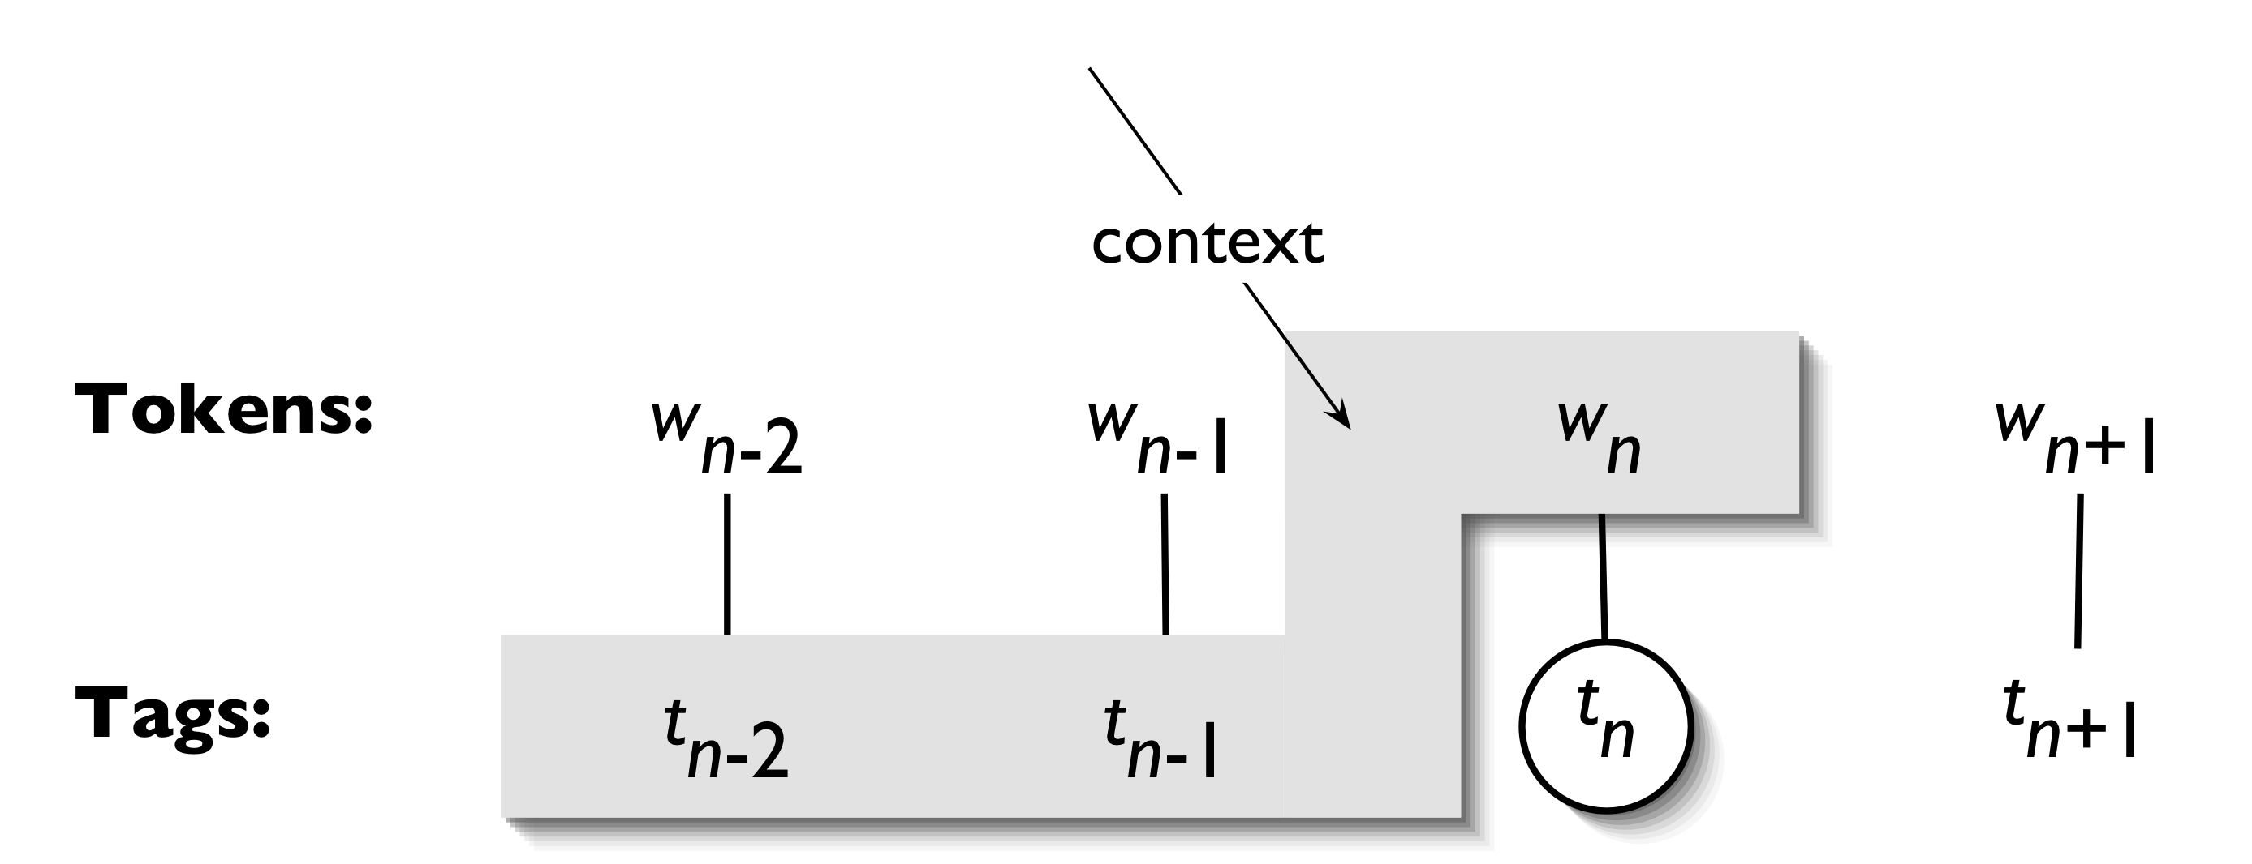
Hidden tags in POS tagging
In sequence labelling we don’t know the last tag…
  get sequence of M words, need to output M tags (classes)
  the tag sequence is hidden and must be inferred
  nb. may have tags for training set, but not in general (testing set)

Slide 4
Predicting sequences
Have to produce sequence of M tags
Could treat this as classification…
  e.g., one big ‘label’ encoding the full sequence
  but there are exponentially many combinations, |Tags|^{M}
  how to tag sequences of differing lengths?
A solution: learning a local classifier
  e.g., Pr(t_{n} | w_{n}, t_{n-2}, t_{n-1}) or P(w_{n,} t_{n} | t_{n-1})
  still have problem of finding best tag sequence for w
  can we avoid the exponential complexity?

Slide 5
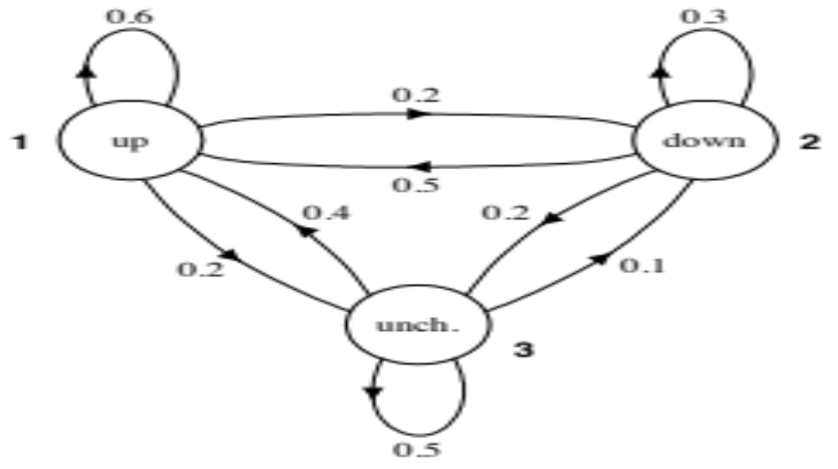
Markov Models
Characterised by
  set of states
  initial state occ prob
  state transition probs
  outgoing edges normalised
Can score sequences of observations
  For stock price example: up-up-down-up-up
  maps directly to states
  simply multiply probs
      Fig. from Spoken language processing; Huang, Acero, Hon (2001); Prentice Hall

Slide 6
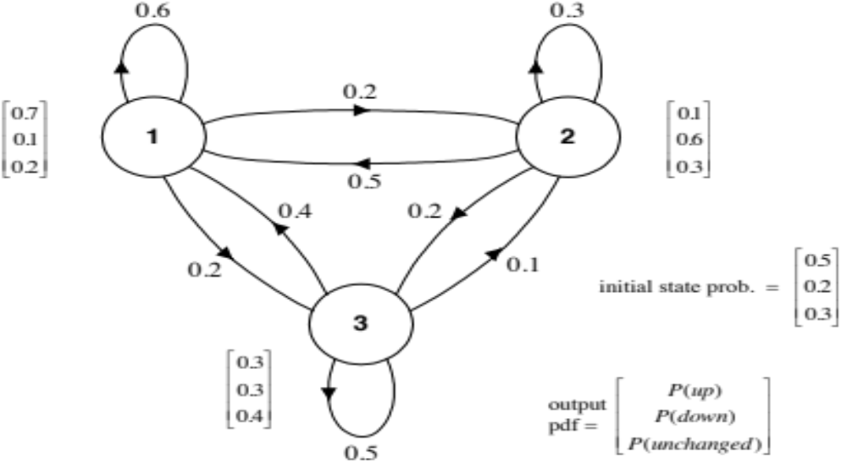
Hidden Markov Models
Each state now has in addition
  emission prob vector
No longer 1:1 mapping
  from observation sequence to states
  E.g., up-up-down-up-up could be generated from any state sequence
  but some more likely than others!
State sequence is ‘hidden’
      Fig. from Spoken language processing; Huang, Acero, Hon (2001); Prentice Hall

Slide 7
Notation
Basic units are a sequence of
  O, observations e.g., words
  Ω, states e.g., POS tags
Model characterised by
  initial state probs π = vector of |Ω| elements
  transition probs A = matrix of |Ω| x |Ω|
  emission probs O = matrix of |Ω| x |O|
Together define the probability of a sequence
  of observations together with their tags
  a model of P(w, t)
Notation: w = observations; t = tags; i = time index

Slide 8
Assumptions
Two assumptions underlying the HMM
Markov assumption
  states independent of all but most recent state
  P(t_{i} | t₁, t₂, t₃, …, t_{i-2}, t_{i-1}) = P(t_{i} | t_{i-1})
  state sequence is a Markov chain
Output independence
  outputs dependent only on matching state
  P(w_{i} | w₁, t₁, …, w_{i-1}, t_{i-1}, t_{i}) = P(w_{i} | t_{i})
  forces the state t_{i} to carry all information linking w_{i} with neighbours
Are these assumptions realistic?

Slide 9
Probability of sequence
Probability of sequence “up-up-down”
  1,1,2 is the highest prob hidden sequence
  total prob is 0.054398, not 1 - why??
State seq | up π | O | up A | O | down A | O | total
1,1,1 | 0.5 x | 0.7 x | 0.6 x | 0.7 x | 0.6 x | 0.1 = | 0.00882
1,1,2 | 0.5 x | 0.7 x | 0.6 x | 0.7 x | 0.2 x | 0.6 = | 0.01764
1,1,3 | 0.5 x | 0.7 x | 0.6 x | 0.7 x | 0.2 x | 0.3 = | 0.00882
1,2,1 | 0.5 x | 0.7 x | 0.2 x | 0.1 x | 0.5 x | 0.1 = | 0.00035
1,2,2 | 0.5 x | 0.7 x | 0.2 x | 0.1 x | 0.3 x | 0.6 = | 0.00126
…
3,3,3 | 0.3 x | 0.3 x | 0.5 x | 0.3 x | 0.5 x | 0.3 = | 0.00203

Slide 10
HMM Challenges
Given observation sequence(s)
  e.g., up-up-down-up-up
Decoding Problem
  what states were used to create this sequence?
Other problems
  what is the probability of this observation sequence under any state sequence
  how can we learn the parameters of the model from sequence data, without labelled data, i.e., the states are hidden?

Slide 11
HMMs for tagging
Recall part-of-speech tagging
  time/Noun flies/Verb like/Prep an/Art arrow/Noun
What are the units?
  words = observations
  tags = states
Key challenges
  estimate model from state-supervised data
  e.g., based on frequencies
    denoted “Visible Markov Model” in MRS text
    A_{verb,noun} = how often does Verb follow Noun, versus other tags?
  prediction for full tag sequences

Slide 12
Example
time/Noun flies/Verb like/Prep an/Art arrow/Noun
  Prob = P(Noun) P(time | Noun) ⨉
  P(Verb | Noun) P(flies | Verb) ⨉
  P(Prep | Verb) P(like | Prep) ⨉
  P(Art | Prep) P(an | Art) ⨉
  P(Noun | Art) P(arrow | Noun)
… for the other reading
  Prob = P(Noun) P(time | Noun) ⨉
  P(Noun | Noun) P(flies | Noun) ⨉
  P(Verb | Noun) P(like | Verb) ⨉
  P(Art | Prep) P(an | Art) ⨉
  P(Noun | Art) P(arrow | Noun)
Which do you think is more likely?

Slide 13
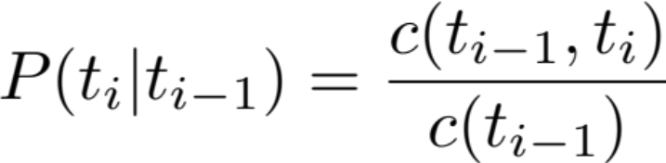
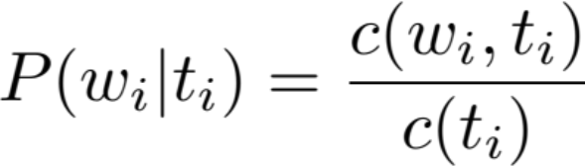
Estimating a visible Markov tagger
Estimation
  what values to use for P(w | t)?
  what values to use for P(t_{i} | t_{i-1}) and P(t₁)?
  how about simple frequencies, i.e.,
  (probably want to smooth these, e.g., adding 0.5)
Notes:
P(t_i | t_{i-1}) = \frac{c(t_{i-1}, t_i)}{c(t_{i-1})}

Slide 14
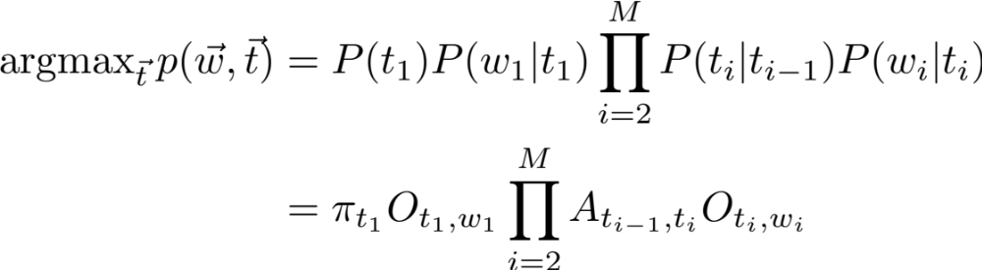
Prediction
Prediction
  given a sentence, w, find the sequence of tags, t
  problems
    exponential number of values of t
    but computation can be factorised…
Notes:
\operatorname{argmax}_{\vec{t}} p(\vec{w}, \vec{t})
& = P(t_1) P(w_1 | t_1) \prod_{i=2}^M P(t_i | t_{i-1}) P(w_i | t_i) \\
& = \pi_{t_1} O_{t_1,w_1} \prod_{i=2}^M A_{t_{i-1}, t_i} O_{t_i, w_i}

Slide 15
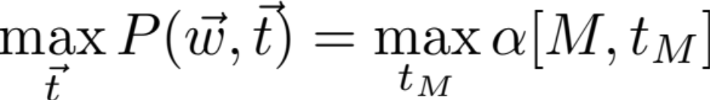
Viterbi algorithm
Form of dynamic programming to solve maximisation
  define matrix α of size M (length) x T (tags)
  full sequence max is then
  how to compute α?
Note: we’re interested in the arg max, not max
  this can be recovered from α with some additional book-keeping
Notes:
\alpha[i, t_i] & = \max_{t_1 \cdots t_{i-1}} P(w_1 \cdots w_i, t_1 \cdots t_i)
\max_{\vec{t}} P(\vec{w}, \vec{t}) = \max_{t_M} \alpha[M, t_M]

Slide 16
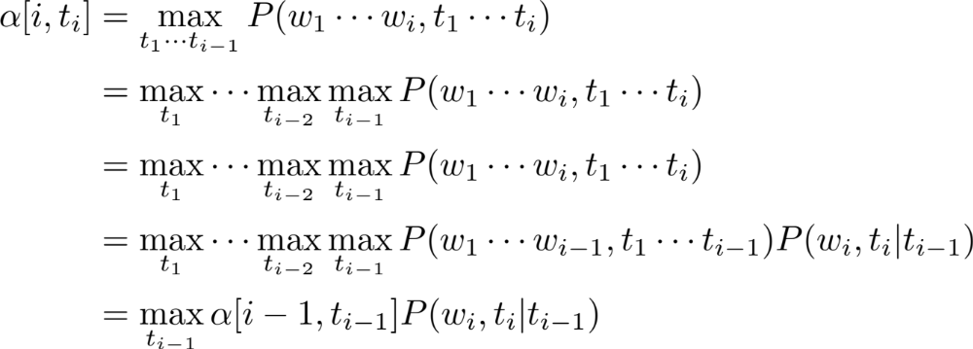

Defining α
Can be defined recursively
Need a base case to terminate recursion
Notes:
\alpha[i, t_i] & = \max_{t_1 \cdots t_{i-1}} P(w_1 \cdots w_i, t_1 \cdots t_i) \\
& = \max_{t_1} \cdots \max_{t_{i-2}} \max_{t_{i-1}} P(w_1 \cdots w_i, t_1 \cdots t_i) \\
& = \max_{t_1} \cdots \max_{t_{i-2}} \max_{t_{i-1}} P(w_1 \cdots w_i, t_1 \cdots t_i) \\
& = \max_{t_1} \cdots \max_{t_{i-2}} \max_{t_{i-1}} P(w_1 \cdots w_{i-1}, t_1 \cdots t_{i-1}) P(w_i, t_i | t_{i-1}) \\
& = \max_{t_{i-1}} \alpha[i-1, t_{i-1}] P(w_i, t_i | t_{i-1})

Slide 17
Viterbi illustration
0.35 x 0.6 x 0.7 = 0.147
0.147 x …
1
1
1
0.5 x 0.7 = 0.35
0.02 x 0.5 x 0.7 = 0.007
0.147 x …
start
2
2
2
0.2 x 0.1 = 0.02
0.147 x …
0.09 x 0.4 x 0.7 = 0.0252
0.3 x 0.3 = 0.09
3
3
3
All maximising sequences with t₂=1 must also have t₁=1
No need to consider extending [2,1] or [3,1].

Slide 18
Viterbi analysis
Algorithm as follows
Time complexity is O(M T²)
  nb. better to work in log-space, adding log probabilities
alpha = np.zeros(M, T)
for t in range(T):
alpha[1, t] = pi[t] * O[w[1], t]
for i in range(2, M):
for t_i in range(T):
for t_last in range(T):
alpha[i,t_i] = max(alpha[i,t_i],
alpha[i-1, t_last] * A[t_last, t_i] *
O[w[i], t_i])
best = np.max(alpha[M,:])

Slide 19
Backpointers
Don’t just store max values, α
  also store the argmax `backpointer’
  can recover best t_{M-1} from δ[M,t_{M}]
  and t_{M-2} from δ[M-1,t_{M-1}]
  …
  stopping at t₁
Notes:
\alpha[i, t_i] & = \max_{t_{i-1}} \alpha[i-1, t_{i-1}] P(w_i, t_i | t_{i-1})
\delta[i, t_i] & = \operatorname{argmax}_{t_{i-1}} \alpha[i-1, t_{i-1}] P(w_i, t_i | t_{i-1})

Slide 20
MEMM taggers
Change in HMM parameterisation from generative to discriminative
  change from Pr(w, t) to Pr(t | w); and
  change from Pr(t_{i} | t_{i-1}) Pr(w_{i} | t_{i}) to Pr(t_{i} | w_{i}, t_{i-1})
E.g.
  time/Noun flies/Verb like/Prep …
  Prob = P(Noun | time) ⨉ P(Verb | Noun, flies) ⨉ P(Prep | Verb, like)
Modelled using maximum entropy classifier
  supports rich feature set over sentence, w, not just current word
  features need not be independent
Simpler sibling of conditional random fields (CRFs)

Slide 21
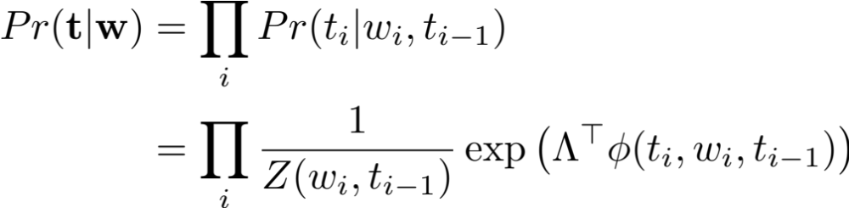
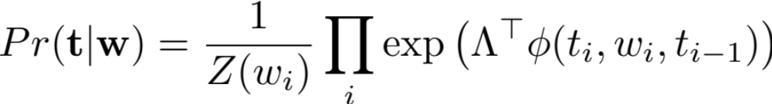
CRF taggers
Take idea behind MEMM taggers
  change `softmax’ normalisation of probability distributions
  rather than normalising each transition Pr(t_{i} | w_{i}, t_{i-1})
  normalise over full tag sequence
  Z can be efficiently computed using HMM’s forward-backward algo
Z is a sum over tags t_{i}
Z is a sum over tag sequences t
Notes:
Pr(\mathbf{t} | \mathbf{w}) &= \prod_i Pr(t_i | w_i, t_{i-1}) \\
& = \prod_i \frac{1}{Z(w_i, t_{i-1})} \exp \left( \Lambda^\top \phi(t_i, w_i, t_{i-1}) \right) \\
%& = \exp \left( \sum_i \Lambda^\top \phi(t_i, w_i, t_{i-1}) - \log Z(w_i, t_{i-1}) \right)
Pr^{\text{CRF}}(\mathbf{t} | \mathbf{w}) &= \exp \left( \sum_i \Lambda^\top \phi(t_i, w_i, t_{i-1}) - \log Z^{\text{CRF}}(w_i) \right)

Slide 22
CRF taggers vs MEMMs
Observation bias problem
  given a few bad tagging decisions model doesn’t know how to process the next word
    All/DT the/?? indexes dove
  only option is to make a guess
    tag the/DT, even though we know DT-DT isn’t valid
    would prefer to back-track, but have to proceed (probs must sum to 1)
  known as the ‘observation bias’ or ‘label bias problem’
    Klein D, and Manning, C. "Conditional structure versus conditional estimation in NLP models.” EMNLP 2002.
Contrast with CRF’s global normalisation
  can give all outgoing transitions low scores (no need to sum to 1)
  these paths will result in low probabilities after global normalisation

Slide 23
Aside: unsupervised HMM estimation
Learn model without only words, no tags
  Baum-Welch algorithm, maximum likelihood estimation for
  P(w) = ∑_{t} P(w, t)
  variant of the Expectation Maximisation algorithm
    guess model params (e.g., random)
    1) estimate tagging of the data (softly, to find expections)
    2) re-estimate model params
    repeat steps 1 & 2
  requires forward-backward algorithm for step 1 (see reading)
  formulation similar to Viterbi algorithm, max → sum
Can be used for tag induction, with some success

Slide 24
HMMs in NLP
HMMs are highly effective for part-of-speech tagging
  trigram HMM gets 96.7% accuracy (Brants, TNT, 2000)
  related models are state of the art
    feature based techniques based on logistic regression & HMMs
    Maximum entropy Markov model (MEMM) gets 97.1% accuracy (Ratnaparki, 1996)
    Conditional random fields (CRFs) can get up to ~97.3%
  scores reported on English Penn Treebank tagging accuracy
Other sequence labelling tasks
  named entity recognition
  shallow parsing …

Slide 25
Information extraction
Task is to find references to people, places, companies etc in text
  Tony Abbott [PERSON] has declared the GP co-payment as “dead, buried and cremated'’ after it was finally dumped on Tuesday [DATE].
Applications in
  text retrieval, text understanding, relation extraction
Can we frame this as a word tagging task?
  not immediately obvious, as some entities are multi-word
  one solution is to change the model
    hidden semi-Markov models, semi-CRFs can handle multi-word observations
  easiest to map to a word-based tagset

Slide 26
IOB sequence labelling
BIO labelling trick applied to each word
  B = begin entity
  I = inside (continuing) entity
  O = outside, non-entity
E.g.,
  Tony/B-PERSON Abbott/I-PERSON has/O declared/O the/O GP/O co-payment/O as/O “/O dead/O , /O buried/O and/O cremated/O ’’/O after/O it/O was/O finally/O dumped/O on/O Tuesday/B-DATE ./O
Analysis
  allows for adjacent entities (e.g., B-PERSON B-PERSON)
  expands the tag set by a small factor, efficiency and learning issues
  often use B-??? only for adjacent entities, not after O label

Slide 27
Shallow parsing
Related task of shallow or ‘chunk’ parsing
  fragment the sentence into parts
    noun, verb, prepositional, adjective etc phrases
    simple non-hierarchical setting, just aiming to find core parts of each phrase
  supports simple analysis, e.g., document search for NPs or finding relations from co-occuring NPs and VPs
E.g.,
  [He NP] [reckons VP] [the current account deficit NP]
  [will narrow VP] [to PP] [only # 18 billion NP] [in PP]
  [September NP] .
  He/B-NP reckons/B-VP the/B-NP current/I-NP account/I-NP deficit/I-NP will/B-VP narrow/I-VP to/B-PP only/B-NP #/I-NP 1.8/I-NP billion/I-NP in/B-PP September/B-NP ./O

Slide 28
CoNLL competitions
Shared tasks at CoNLL
  2000: shallow parsing evaluation challenge
  2003: named entity evaluation challenge
  more recently have considered parsing, semantic role labelling, relation extraction, grammar correction etc.
Sequence tagging models predominate
  shown to be highly effective
  key challenge is incorporating task knowledge in terms of clever features
    e.g., gazetteer features, capitalisation, prefix/suffix etc
    limited ability to do so in a HMM
    feature based models like MEMM and CRFs are more flexible

Slide 29
Summary
Probabilistic models of sequences
  introduced HMMs, a widely used model in NLP and many other fields
  supervised estimation for learning
  Viterbi algorithm for efficient prediction
  related ideas (not covered in detail)
    unsupervised learning with HMMs
    CRFs and other feature based sequence models
  applications to many NLP tasks
    named entity recognition
    shallow parsing

Slide 30
Readings
Choose one of the following on HMMs:
  Manning & Schutze, chapters 9 (9.1-9.2, 9.3.2) & 10 (10.1-10.2)
  Rabiner’s HMM tutorial http://tinyurl.com/2hqaf8
Shallow parsing and named entity tagging
  CoNLL competitions in 2000 and 2003 overview papers
  http://www.cnts.ua.ac.be/conll2000 http://www.cnts.ua.ac.be/conll2003/
[Optional] Contemporary sequence tagging methods
  Lafferty et al, Conditional random fields: Probabilistic models for segmenting and labeling sequence data (2001), ICML
Next lecture
  lexical semantics and word sense disambiguation

